Slide 1

Threats and Attacks on Judges, the Justice System, and Legal Institutions:
Our Ethical Obligations
BPR Annual Ethics Workshop
November 21, 2025
**Abridged Version**

Slide 2
Professional Obligations of Lawyers
Preamble & Comments to the Tennessee Rules of Professional Conduct
“A lawyer, as a member of the legal profession, is a representative of clients, an officer of the legal system, and a public citizen having special responsibility for the quality of justice.”
Tennessee Supreme Court Rule 8, Preamble to the RPC, cmt. 2
**Abridged Version**

Slide 3
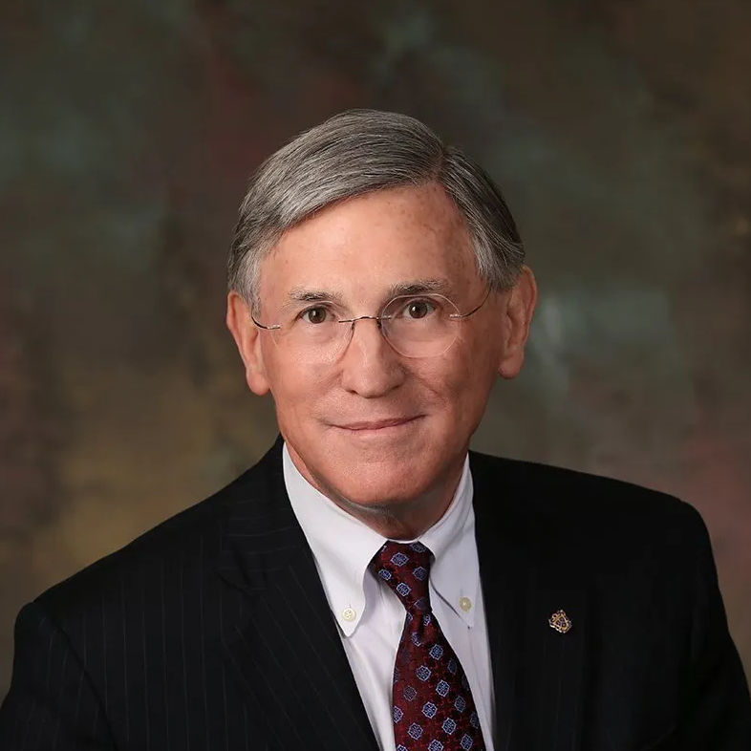
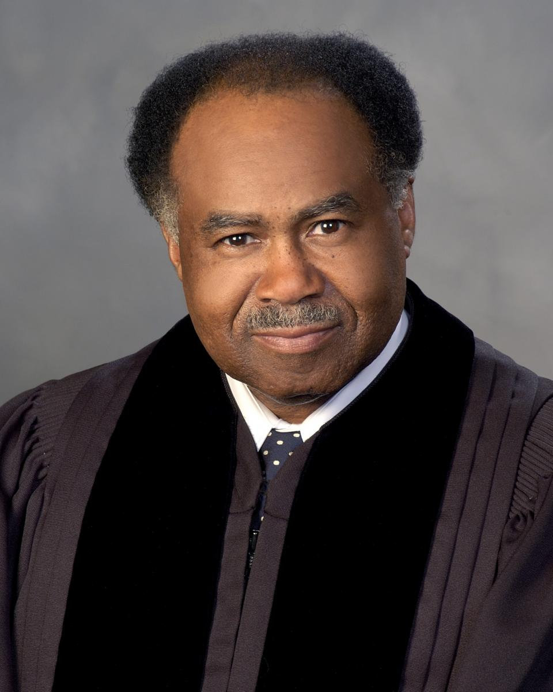
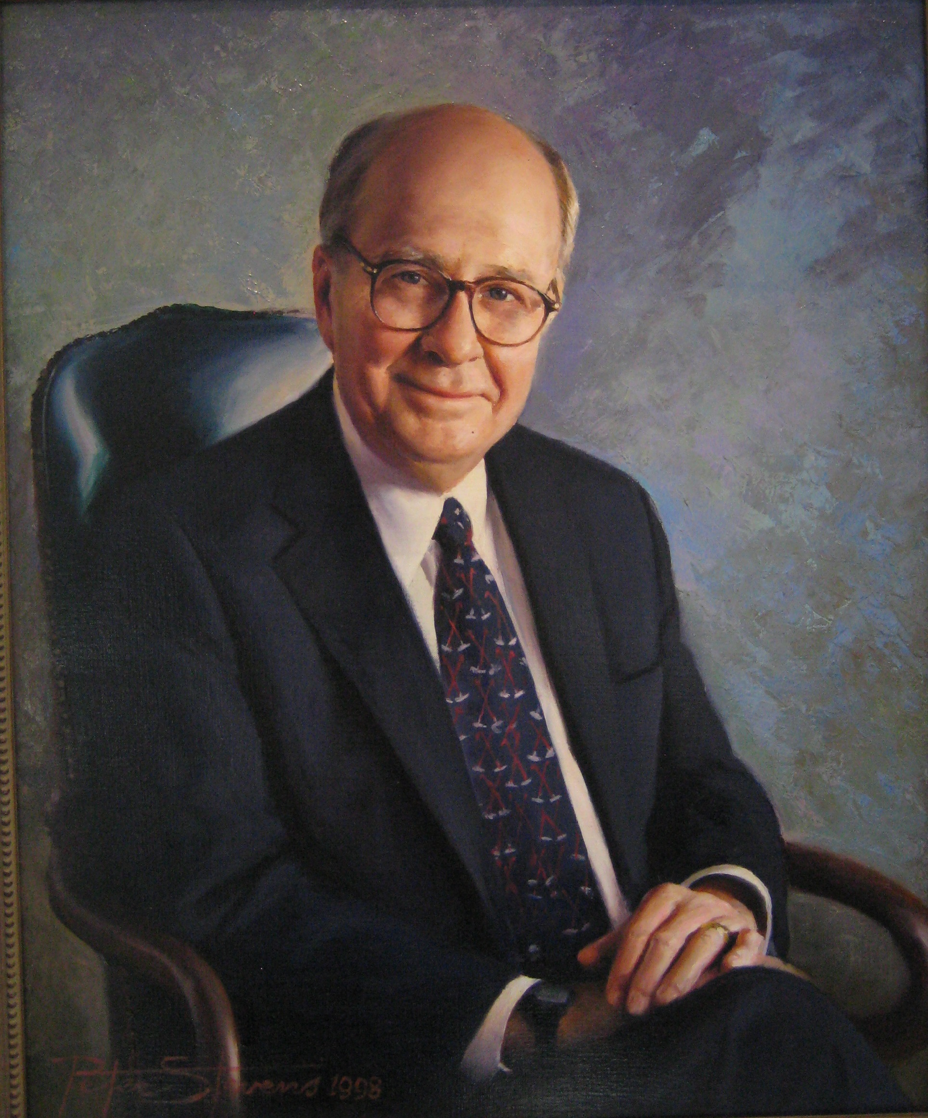
Ethics v. Professionalism
Presentation by Dean William C. Koch at the 2021 BPR Annual Ethics Workshop
There is a difference between professional ethics (enforceable rules) and professionalism (considerations for moral and ethical behavior).
Current ethics rules focus on minimum standards and prohibited conduct that may trigger disciplinary action (i.e., what not to do).
Professionalism sets a higher standard of behavior by focusing on ideal characteristics and aspirational conduct (i.e., what lawyers should do).
William Koch, Dean of Nashville School of Law & TN Supreme Court Justice (retired)
“Ethics is that which is required and professionalism is that which is expected.”
Justice Robert Benham, Evanoff v. Evanoff, 418 S.E.2d 62, 63 (Ga. 1992) (quoting Chief Justice Harold Clark)
**Abridged Version**
Justice Robert Benham,
GA Supreme Court (retired)
Chief Justice Harold Clark,
GA Supreme Court (retired)

Slide 4
Professional Obligations of Lawyers
1908 ABA Canon of Professional Ethics
“It is the duty of the lawyer to maintain towards the Courts a respectful attitude, not for the sake of the temporary incumbent of the judicial office, but for the maintenance of its supreme importance. Judges, not being wholly free to defend themselves, are peculiarly entitled to receive the support of the Bar against unjust criticism and clamor. . . .”
Canon 1, 1908 ABA Canons of Professional Ethics
“It is the duty of the Bar to endeavor to prevent political considerations from outweighing judicial fitness in the selection of Judges. . . .”
Canon 2, 1908 ABA Canons of Professional Ethics
“No client, corporate or individual, however powerful, nor any cause, civil or political, however important, is entitled to receive, nor should any lawyer render, any service or advice involving disloyalty to the law whose ministers we are, or disrespect of the judicial office, which we are bound to uphold . . . . [A]bove all a lawyer will find his highest honor in a deserved reputation for fidelity to private trust and to public duty, as an honest man and as a patriot and loyal citizen.”
Canon 32, 1908 ABA Canons of Professional Ethics
**Abridged Version**

Slide 5
Ethics Rules v. Professional Obligations
Tennessee Rules of Professional Conduct
Rules
“A lawyer shall not seek to influence a judge . . . by means prohibited by law.” RPC 3.5(a).
“A lawyer shall not make a statement that the lawyer knows to be false or that is made with reckless disregard as to its truth or falsity concerning the qualifications or integrity of . . . a judge.” RPC 8.2(a)(1).
“It is professional misconduct for a lawyer to . . . engage in conduct involving dishonesty, fraud, deceit, or misrepresentation.” RPC 8.4(c).
“It is professional misconduct for a lawyer to . . . engage in conduct that is prejudicial to the administration of justice.” RPC 8.4(d).
**Abridged Version**

Slide 6
Ethics Rules v. Professional Obligations
Tennessee Rules of Professional Conduct
“A lawyer should demonstrate respect for the legal system and for those who serve it, including judges, other lawyers, and public officials.” RPC Preamble, cmt. 6.
“[A] lawyer should further the public's understanding of and confidence in the rule of law and the justice system because legal institutions in a constitutional democracy depend on popular participation and support to maintain their authority.” RPC Preamble, cmt. 7.
“To maintain the fair and independent administration of justice, lawyers are encouraged to continue traditional efforts to defend judges and courts unjustly criticized and to responsibly speak out when necessary to prevent or rectify injustice or to promote needed improvements in the judicial system.” RPC 8.2, cmt. 3.
“In both their professional and personal activities, lawyers have special obligations to demonstrate respect for the law and legal institutions. . . .” RPC 8.4, cmt. 9.
Obligations
**Abridged Version**

Slide 7
**Abridged Version**
The full Powerpoint will be made available on or after November 21, 2025.

